Slide 1
Capacitive Shield for Charger Artifact Reduction for Implants
Neuralink, US 2023/0198316, A1
3/30/2024

Slide 2
Outline
Goal: Describe shielded coils (transmitting + receiving) for wireless power transmission into medical implant
Embodiments:
  Perspective view of implanted neural device with and without charging coil
  Exploded view of charging coil over implanted neural device
  Top view of transmitter shield
  Perspective view of implant
  Cross-section of implant
  Top view of unfolded receiver shield
  Overall Procedure

Slide 3
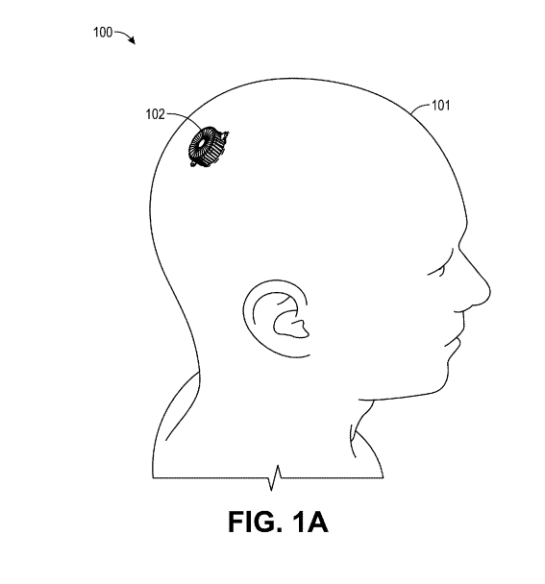
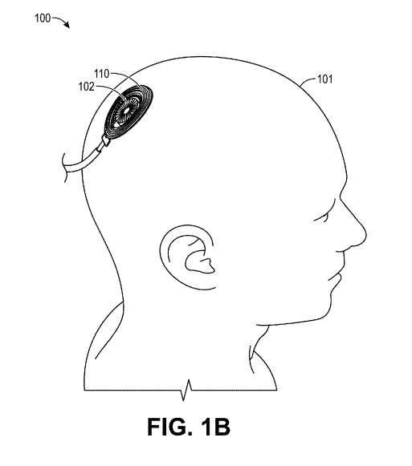
Perspective view of implanted neural device with (left) and without (right) charging coil

Slide 4
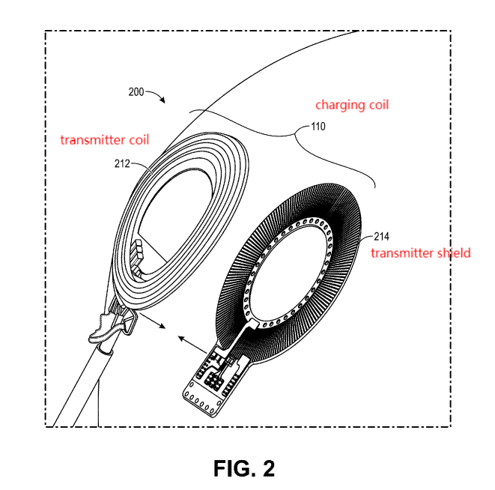
Exploded view of charging coil

Slide 5
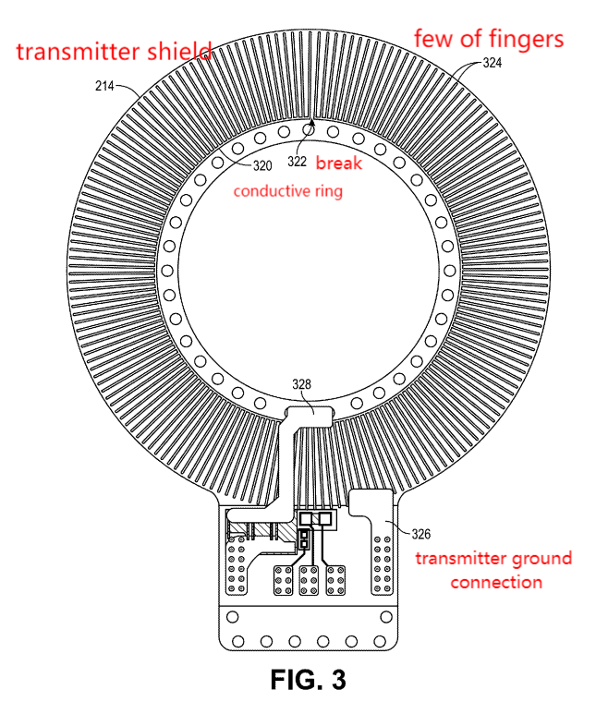
Top view of transmitter shield

Slide 6
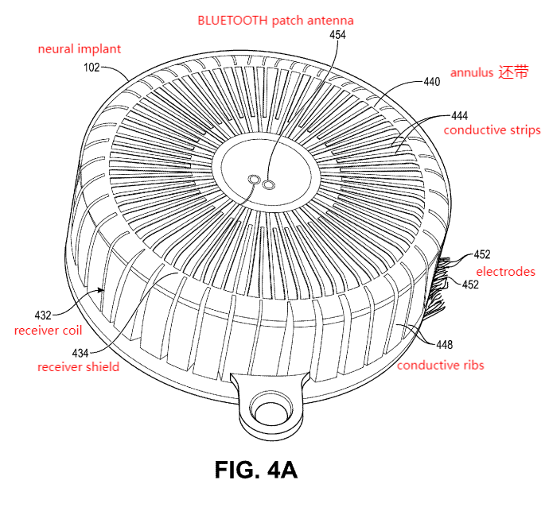
Perspective view of implant

Slide 7
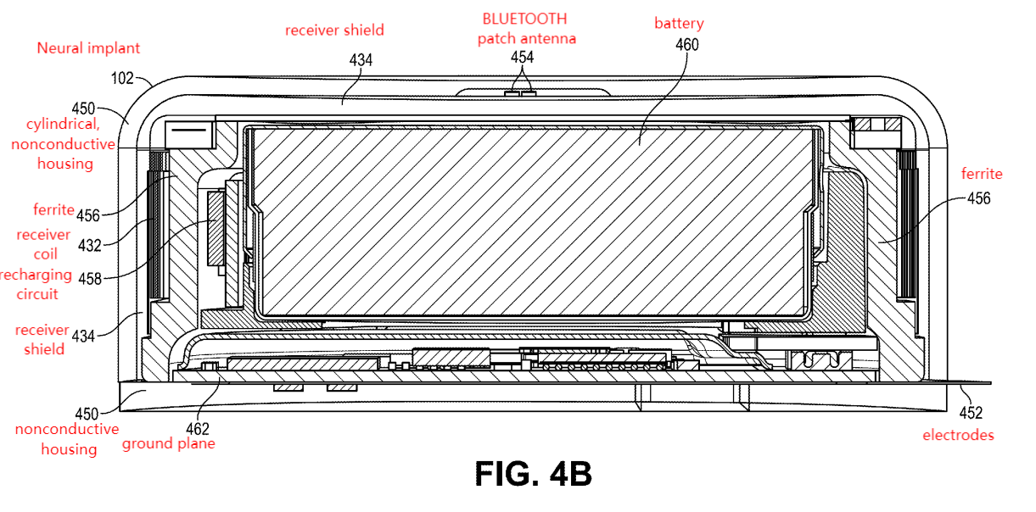
Cross-section view of implant

Slide 8
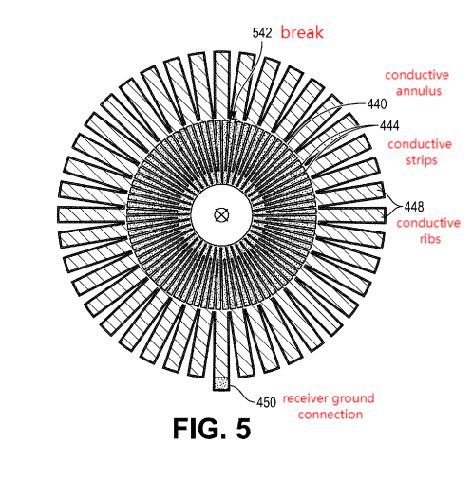
Top view of unfolded receiver shield
Folded into a cup around receiver coil in 4A-4B

Slide 9
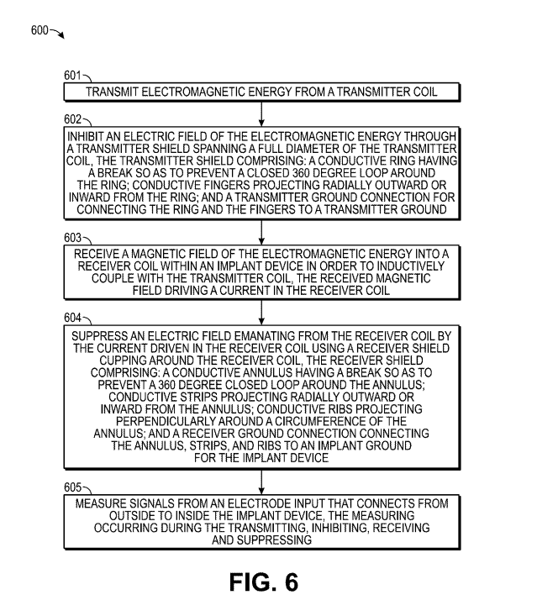
Overall Procedure

Slide 10
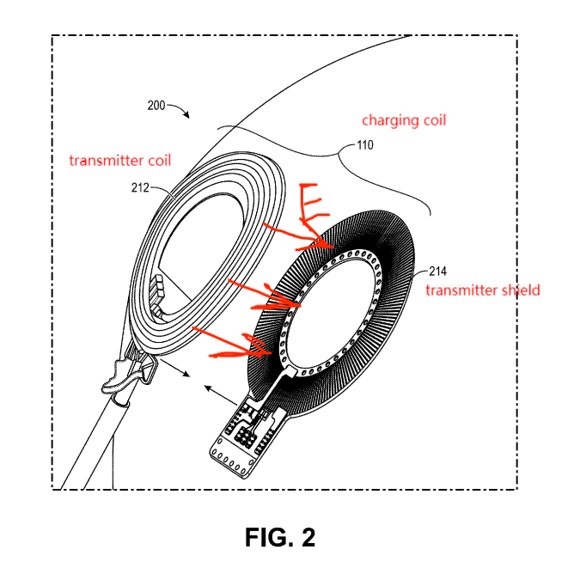
Step 1: Transmit

Slide 11
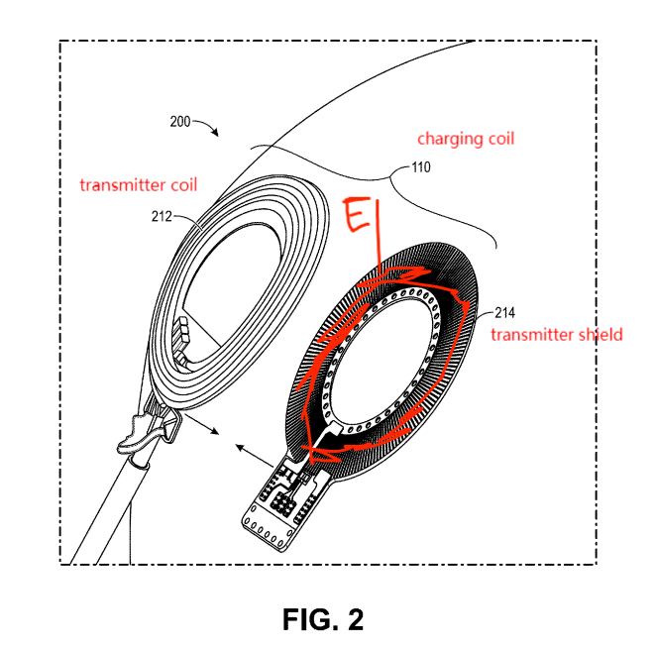
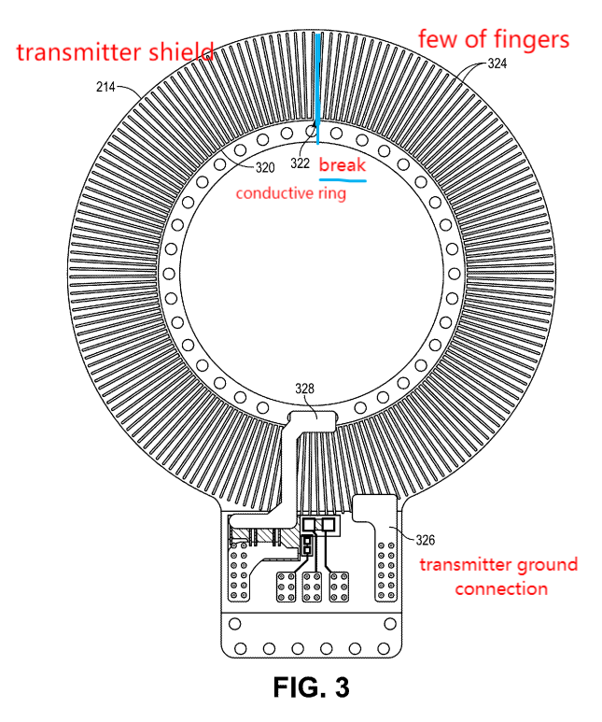
Step 2: Inhibit

Slide 12
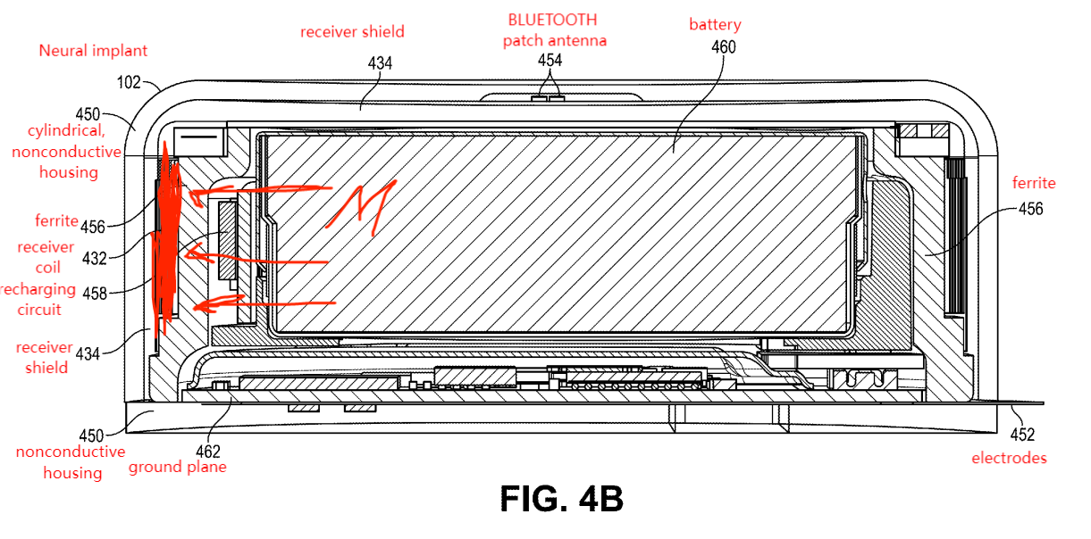
Step 3: Receive

Slide 13
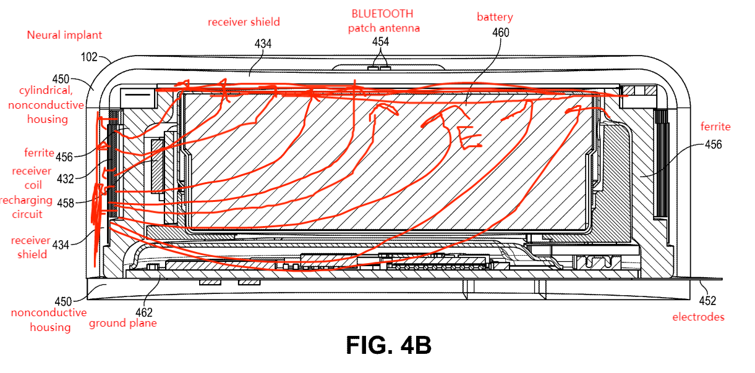
Step 4: Suppress

Slide 14
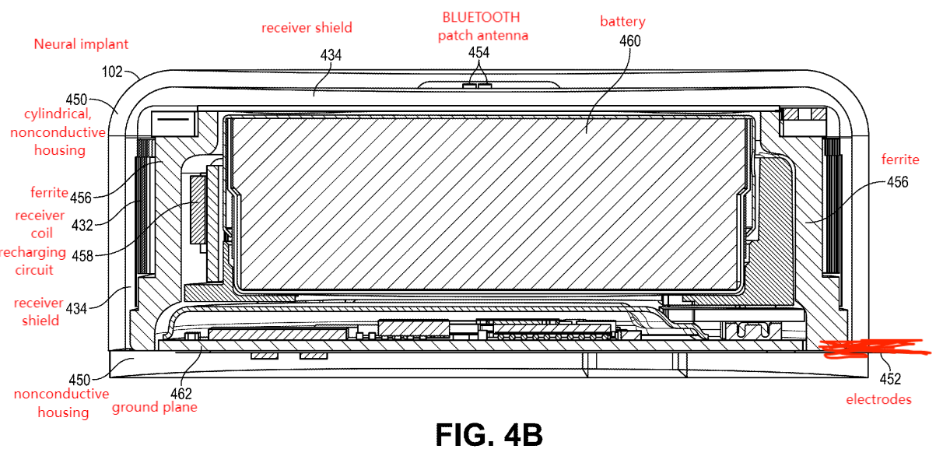
Step 5: Measure

